Slide 1

Dimensionality reduction.
PCA
DATA ANALYTICS | IRONHACK

Slide 2

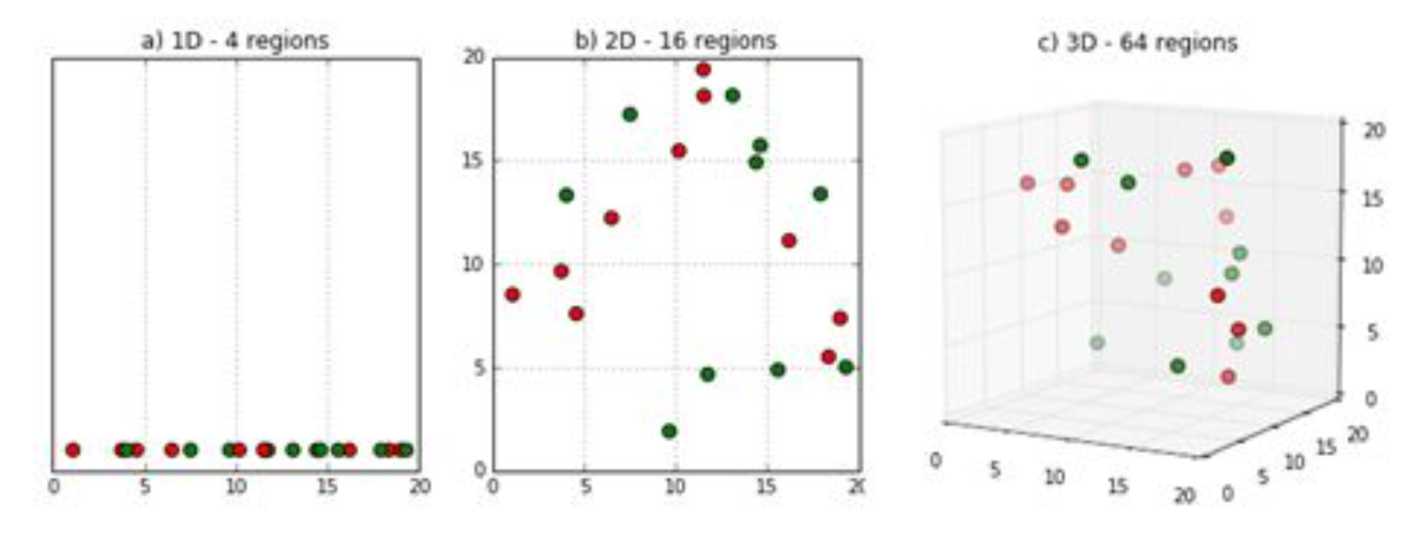
IRONHACK BOOTCAMP
CURSE OF DIMENSIONALITY
There more features, the lesser density of observations in each region of features

Slide 3


IRONHACK BOOTCAMP
THE MAIN IDEA
Switch to another set of features which capture the variability of the data.
The new dataset will have exactly the same amount of features (called principal components) than the original dataset.
Only a few principal components are retained.
The explanatory variable is not taken into account during the process!
The principal components are linear combinations of the original features

Slide 4
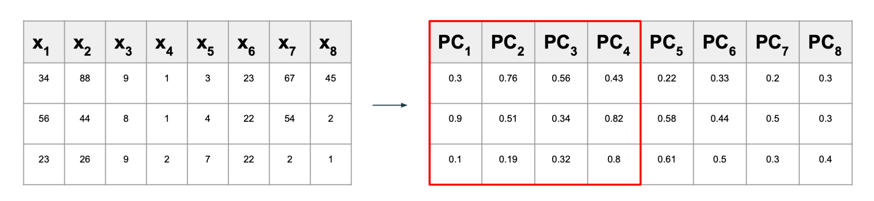
IRONHACK BOOTCAMP
THE MAIN IDEA

Slide 5
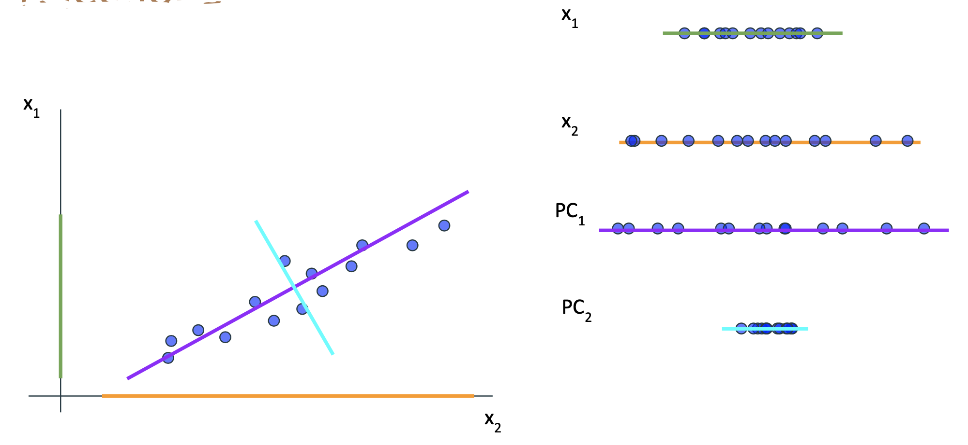
IRONHACK BOOTCAMP
THE GRAPHICAL IDEA
Rotations of the original features

Slide 6
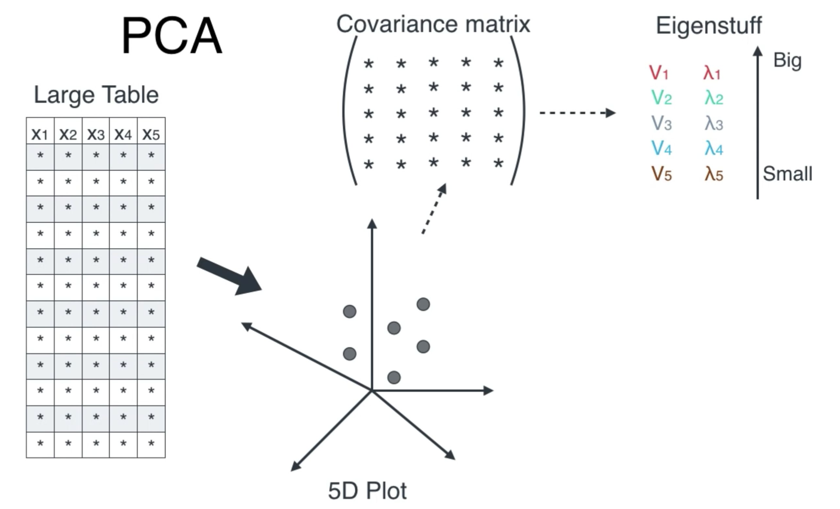
IRONHACK BOOTCAMP
DETERMINING THE COEFFICIENTS
The eigenvalues gives us the variance of each principal component.
The components of each eigenvector gives us the coefficients of each linear combination.

Slide 7
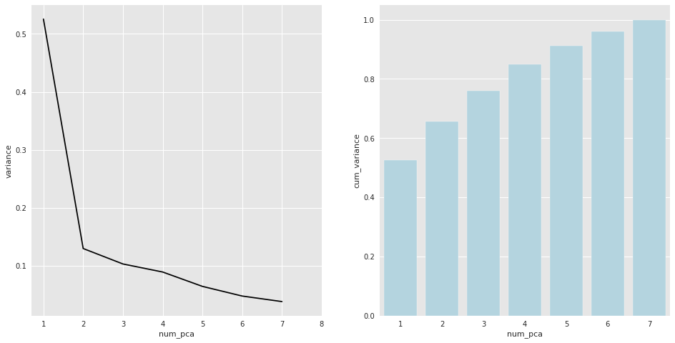
IRONHACK BOOTCAMP
HOW MANY PRINCIPAL COMPONENTS WE KEEP?
We have two possible strategies:
Scree plot ( plot the variance explained by each pca and find an elbow )
Select the number of pca’s which explain a minimum amount of the total variance. (typically 80% of the variance)
Keep in mind that if you select a subset of principal components you will not be able to explain all the data!
“The Price of Death”

Slide 8
IRONHACK BOOTCAMP
CAVEAT
There is no warranty that you will find an elbow!
Not always you will be able to explain the dependent feature with some few principal components. (The dependent feature is not taken into account during the process).
You may need to transform the features first in order to standarize them (depends on the library).
PCA in sklearn

Slide 9
IRONHACK BOOTCAMP
ADDITIONAL READING
Principal Component Analysis (PCA)”, by Luis Serrano (26:33) https://www.youtube.com/watch?v=g-Hb26agBFg
“Dimensionality Reduction”, Hands On Machine Learning with Scikit-Learn, Keras & Tensorflow (213-225)

Slide 10


